Slide 1
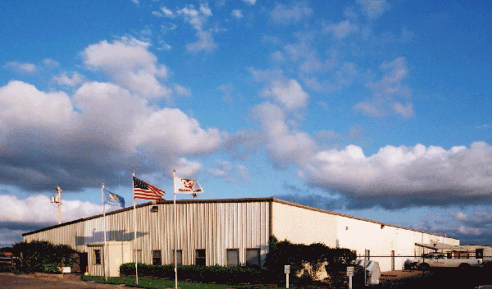
Midwest
COOLING TOWERS, INC
A Brief Overview

Slide 2
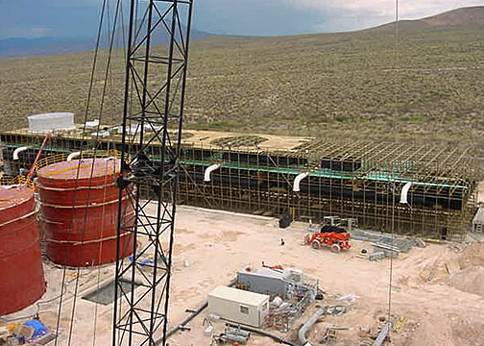
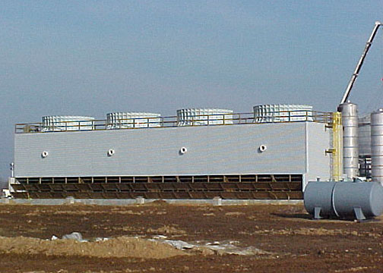
A Full Checklist of Products & Services for Your Cooling Tower Project
Quality
Service
Integrity
Value

Slide 3
Our Mission
A fair profit for all.
Outstanding quality and the best value.
“Old fashioned” customer service while using the latest technology to exceed your expectations.
Continuously maintaining the highest level of integrity with our vendors, our customers and among ourselves.

Slide 4
Company Profile
Founded in 1987
200,000 sq. ft. lumber and fiberglass manufacturing and headquarters facilities in Chickasha, Oklahoma
200 employees in Chickasha and over 250 additional employees in field construction

Slide 5
Company Profile
Manufacture & supply components to over 85 other cooling tower companies & contractors in the U.S. and more than 110 world-wide
Sales offices with national and world-wide representation

Slide 6
Members Of…..

Slide 7
History
1987 - Founded by Larry Brown & Dave Smith
1988 - Purchased 5 acres at current site (now expanded to 20 acres)
1997 - Started employee purchase process
2001 - Merged with Pacific Cooling Services
2003 - Formed new subsidiary, Beetle Plastics, LLC
2004 - Pacific assumes Midwest name
2007 - Employee ownership
2014 – Employee owners sell to new management group

Slide 8
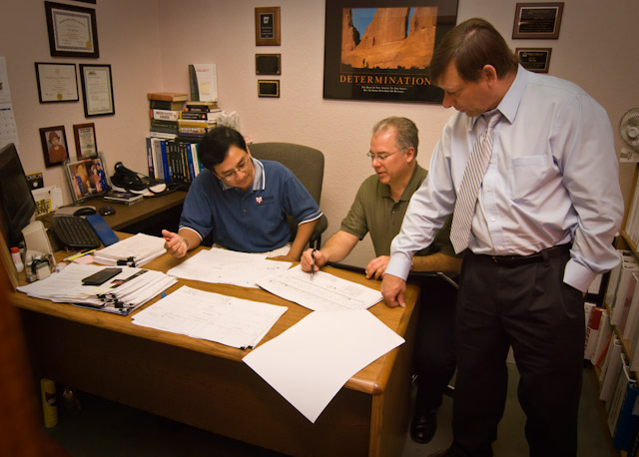
Design & Engineering

Slide 9
Design & Engineering
Experienced team to work with you through design, budgeting, planning and installation.
Fill options to fit your situation
Wood and FRP structures

Slide 10
Design & Engineering
High value, pre-engineered solutions
Custom designs for any application
Custom cell sizes to fit existing basins

Slide 11
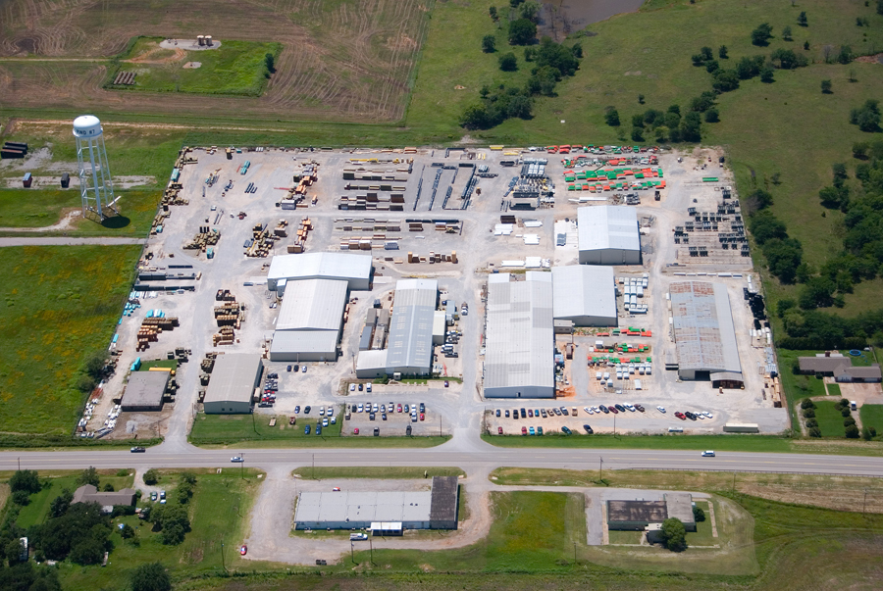
Custom Manufacturing

Slide 12
Custom Manufacturing
Capability & flexibility are our core strengths
200,000 sq. ft.
Experienced staff
Rigorous quality control and assurance
Advanced techniques
Consistent, quality products

Slide 13
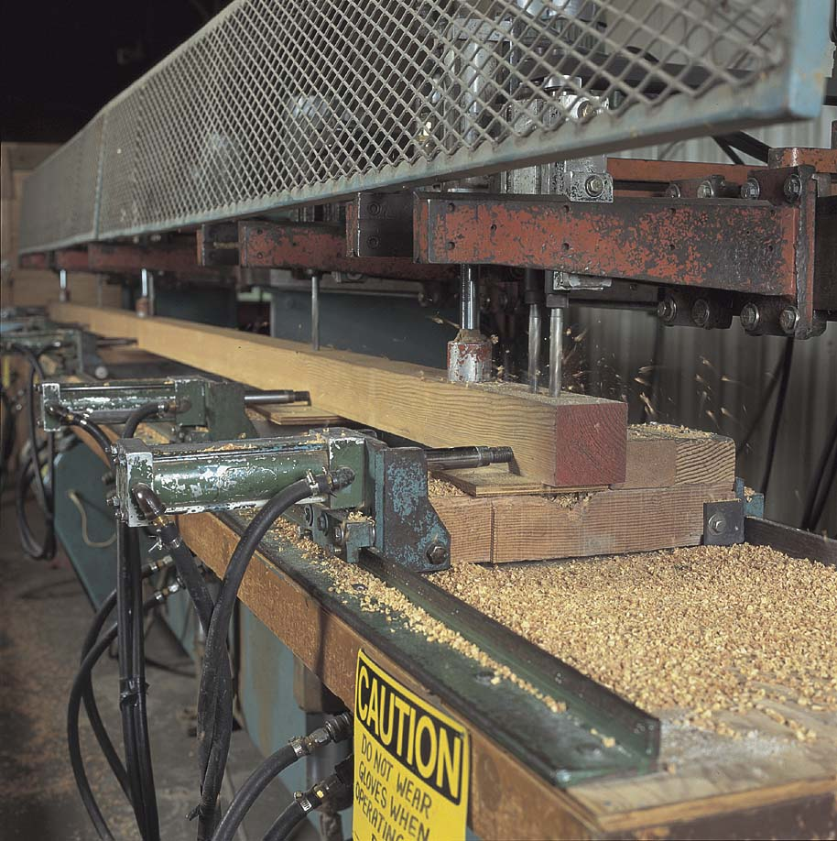
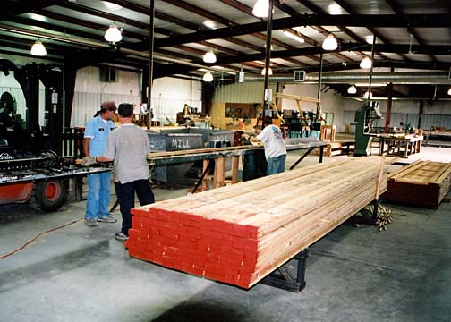
Lumber Fabrication

Slide 14
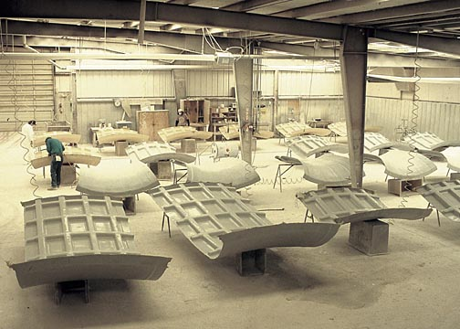
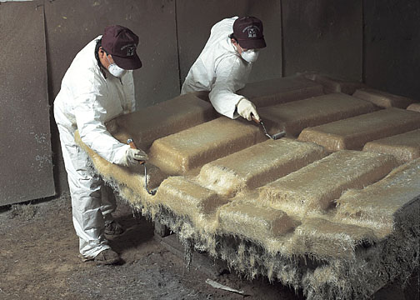
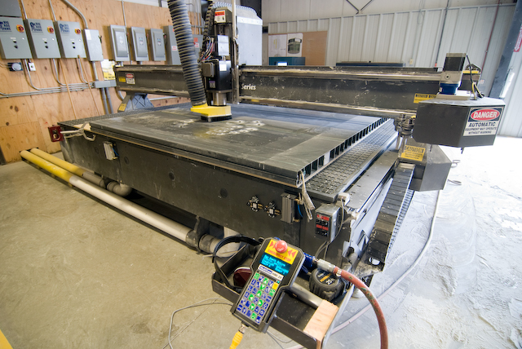
Fiberglass Manufacturing

Slide 15
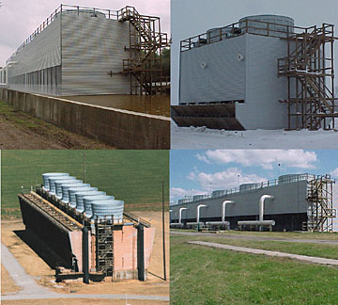
New Construction

Slide 16
New Construction
Experienced engineering & design team
Pre-engineered and custom designs
Extensive manufacturing facilities
Complete control of material and labor
Full-time construction staff

Slide 17
New Construction
Outstanding safety performance
Best-value producer -- no middlemen or subcontractors
Counterflow and crossflow designs
Fill options to fit your application
Wood and FRP structures
Custom cell sizes

Slide 18
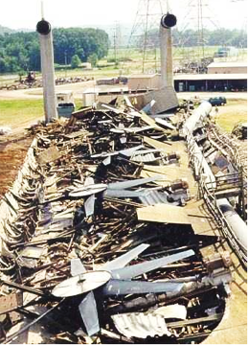
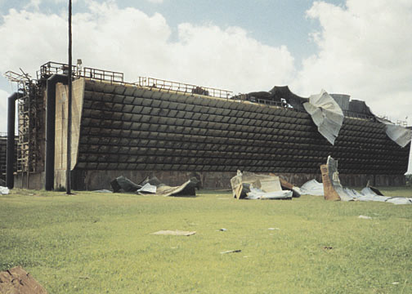
Repair & Emergency Services

Slide 19
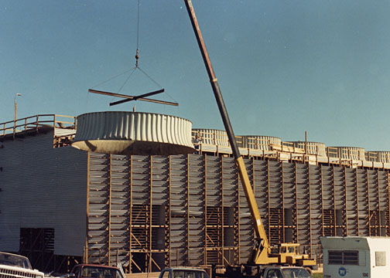
Repair & Emergency Services
Getting you up and running is the most important thing
Fast, effective response
24/7 availability

Slide 20
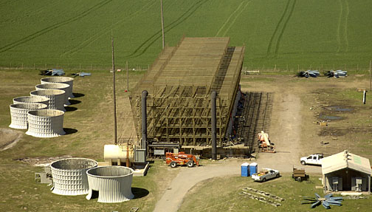
Reconstruction & Upgrade

Slide 21
Reconstruction & Upgrade
Safety is the highest priority and we have an outstanding record
Structural lumber replacement or repair
Structural lumber replacement with custom fiberglass structural shapes
Mechanical equipment repair or upgrade
Fill system replacement

Slide 22
Reconstruction & Upgrade
Drift eliminator system replacement
Fan deck repair / replacement
Hot water basin repair / replacement
Hot water basin covers
Crossflow distribution systems
Counterflow distribution systems
Casing and louver replacement

Slide 23
Reconstruction & Upgrade
Experienced with all makes and models of cooling towers
Thermal performance upgrades
Complete cooling tower refurbishments

Slide 24
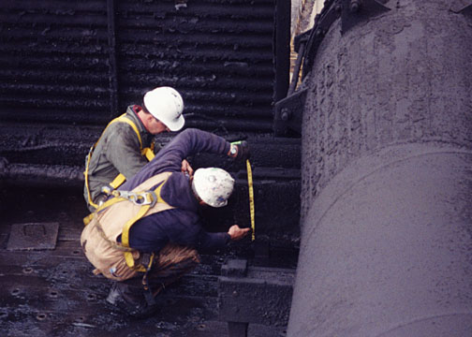
A complete cooling tower maintenance operation and optimization program

Slide 25
Overall cost reductions
Increased thermal performance = potential production increases
Reduced unplanned maintenance and emergency downtime
Virtually error-free parts ordering system
Improved planning, scheduling & budgeting
Access to cooperative parts inventory

Slide 26
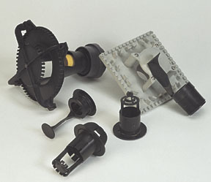
Products
Counterflow cooling towers
Crossflow cooling towers
Parts and components

Slide 27
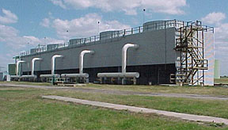
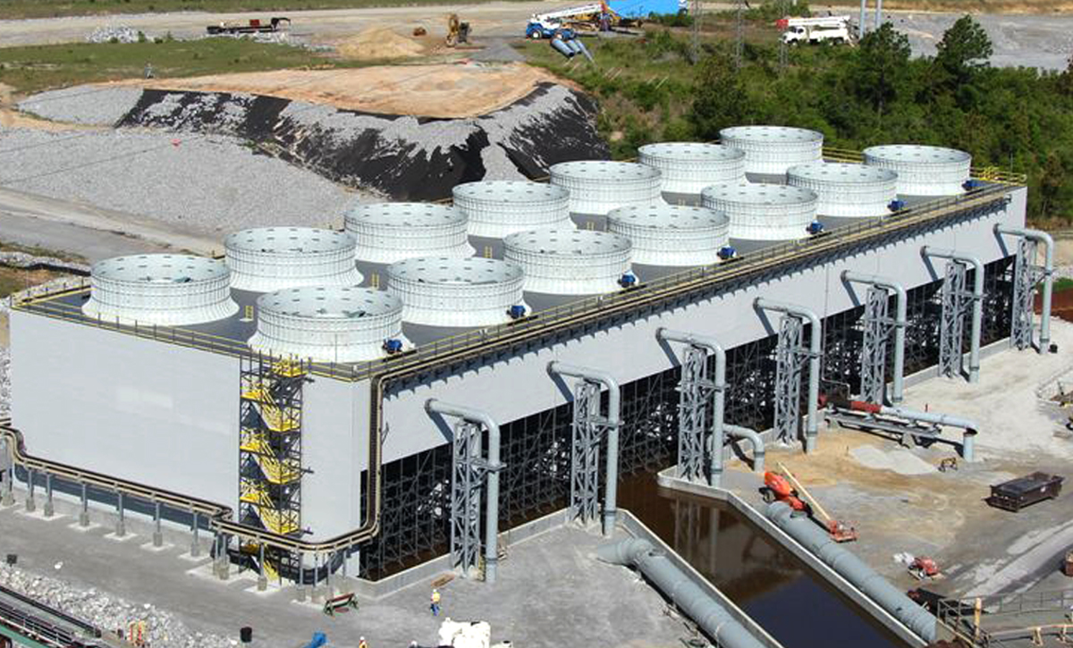
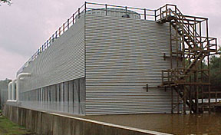
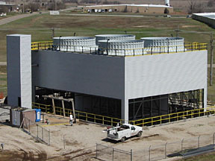
Counterflow Cooling Towers

Slide 28
Counterflow Cooling Towers
Space-efficient design
Maximum thermal performance from given plan area
Can help minimize pump head requirements
Wide choice of models, cell sizes and components
Choice of wood or fiberglass composite structure

Slide 29
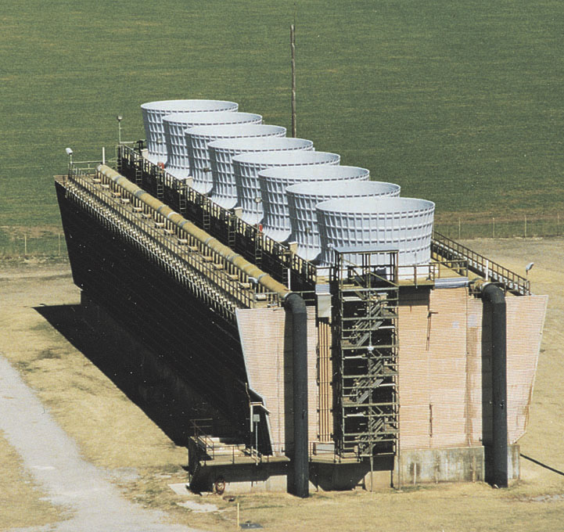
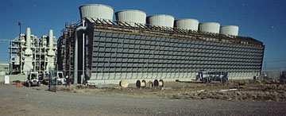
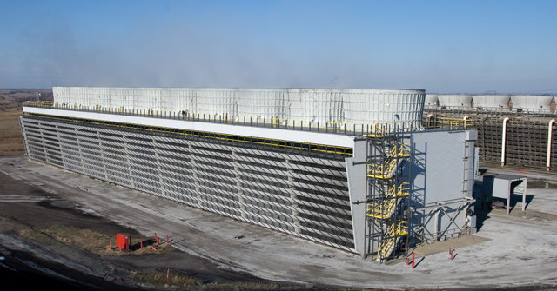
Crossflow Cooling Towers

Slide 30
Crossflow Cooling Towers
Classic, proven design
Excellent, easy access to all key components minimizes hassle for maintenance personnel
Wide choice of models, cell sizes and components
Choice of wood or fiberglass composite structural materials

Slide 31
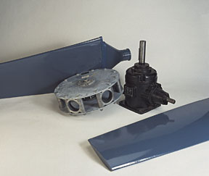
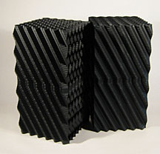
Parts & Components

Slide 32
Parts & Components
High quality, reliable, low-cost alternative to expensive original equip. parts
Large selection
Compatible with virtually all models and manufacturers
Our large buying power results in cost savings passed directly to you

Slide 33
Parts & Components
Custom lumber fabrication and treating
Fiberglass fan stacks and distribution systems
Custom fiberglass wood replacement structural shapes
Non-skid fiberglass fan deck and hot water basins

Slide 34
Parts & Components
Corrugated FRP casing and louvers
Fans and assemblies, gears, speed reducers, drive shafts, couplings, motors, supports
Flow control valves, nozzles, grommets
Fill and drift eliminators
Hardware, brace connectors, base anchors

Slide 35
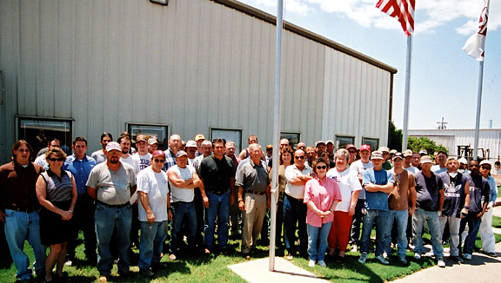
We’re looking forward to working with you!

Slide 36
Midwest
COOLING TOWERS, INC
Chickasha, OK Tel 405.224.4622 Fax 405.224.4625
www.mwcooling.com sales@mwcooling.com

